Slide 1
CSE 6389: Final Project
Reza etemadi idgahi
Divya saxena

Slide 2
Overview
Preparing the data
4 architectures for classifier:
GCN + CNN
GCN + RNN
CNN
GCN
Datasets Used :
common_fiber_matrix(Dataset for project 2)
average_fmri_feature_matrix(Dataset for project 3)
Steps to prevent overfitting
Results

Slide 3
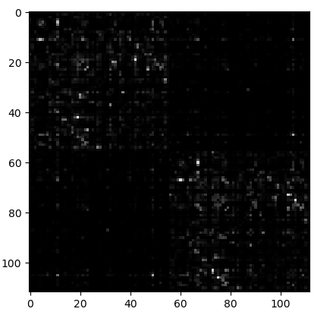
Preparing the data
“common_fiber_matrix.txt” files from the 2nd project are used.
Matrices with size of 150x150
Resized to 112x112
Flatten into 1-dimensional array

Slide 4
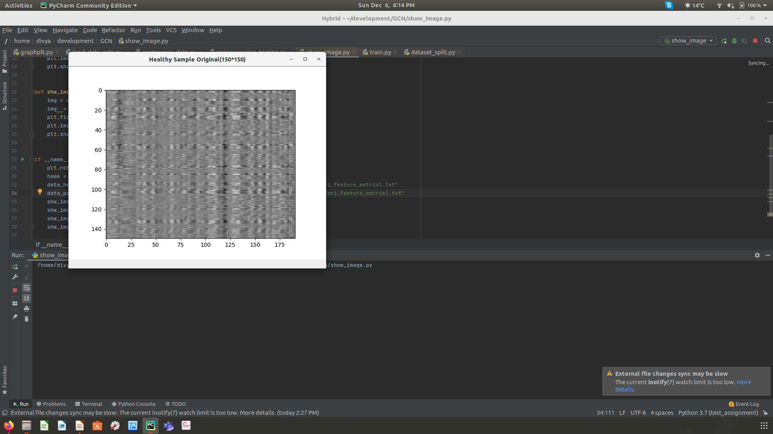
Preparing the data
“average_fmri_feature_matrix.txt” files from the 3rd project are used.
Matrices with different sizes
Resized to 112x112
Flatten into 1-dimensional array

Slide 5
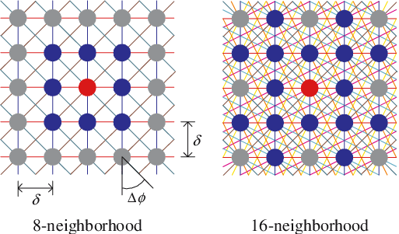
GCN + CNN
Creation of adjacency matrix:
based on the following work
“Convolutional Neural Networks on Graphs with Fast Localized Spectral Filtering” by Michaël Defferrard, Xavier Bresson, Pierre Vandergheynst, NIPS 2016
The K-NN graph is statically determined from a regular grid of pixels using the 2d coordinates.
Every pixel is a node.
Two nodes are connected if they are neighbors according to the K-NN graph.
The node features of each graph are the images vectorized and rescaled to [0,1].

Slide 6
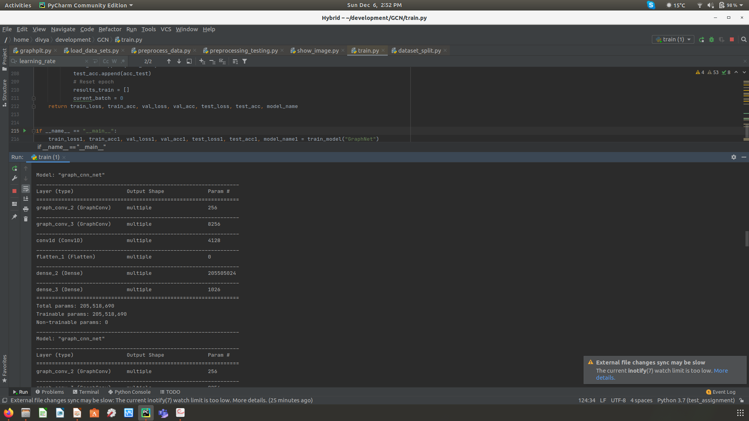
GCN + CNN
Model architecture:
GraphConv(128, activation='elu')
GraphConv(64, activation='elu')
Conv1D(32, kernel_size=(2), kernel_initializer = 'he_uniform')
Dense(512, activation='relu')
Dense(total_classes, activation='softmax')

Slide 7
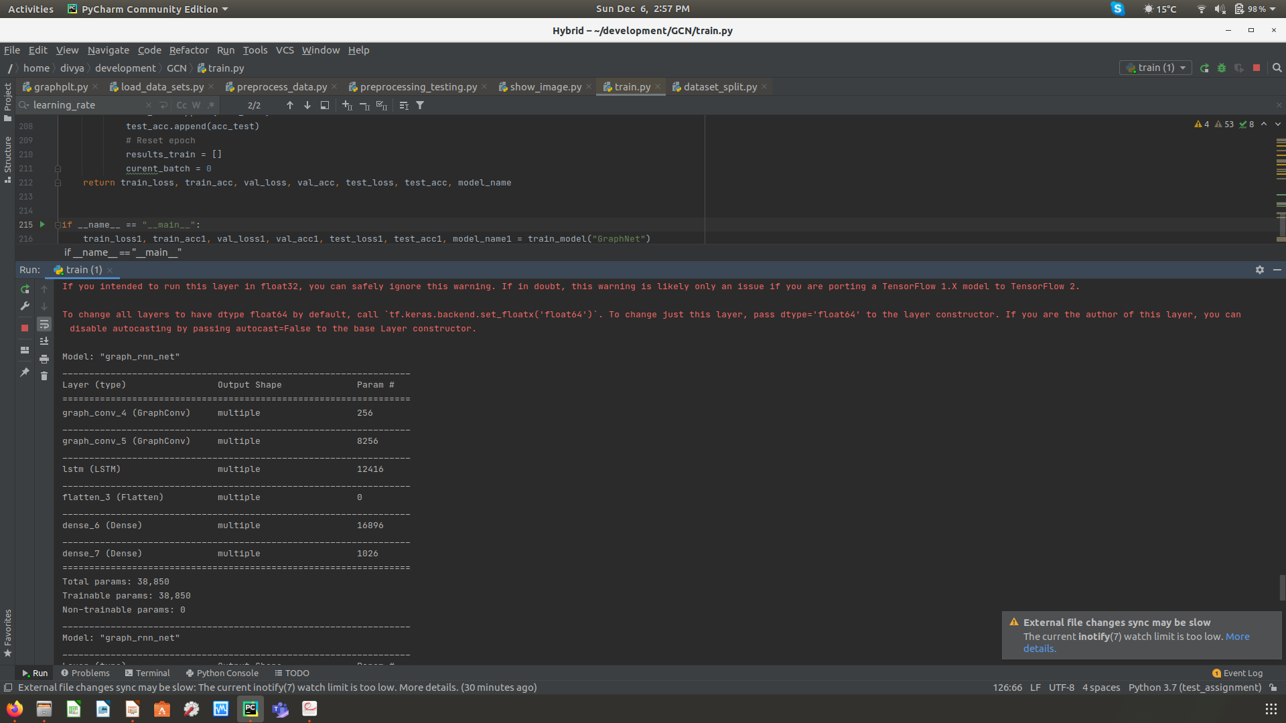
GCN + RNN
Model architecture:
GraphConv(128, activation='elu')
GraphConv(64, activation='elu')
LSTM(32, kernel_initializer = 'he_uniform')
Dense(512, activation='relu')
Dense(total_classes, activation='softmax')

Slide 8
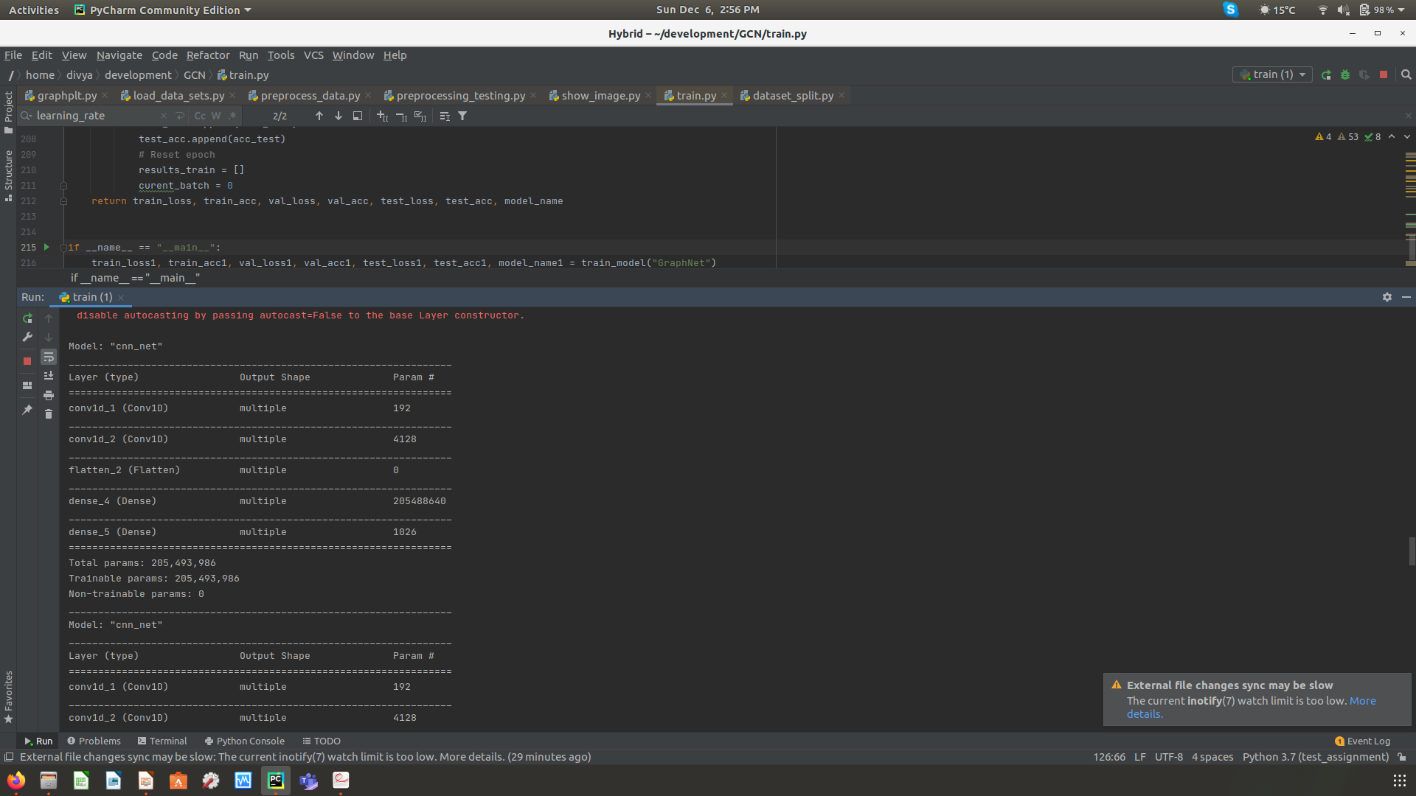
CNN
Model architecture:
Conv1D(64, kernel_size=(2), activation='elu')
Conv1D(32, kernel_size=(2), activation='elu')
Dense(512, activation='relu')
Dense(total_classes, activation='softmax')

Slide 9
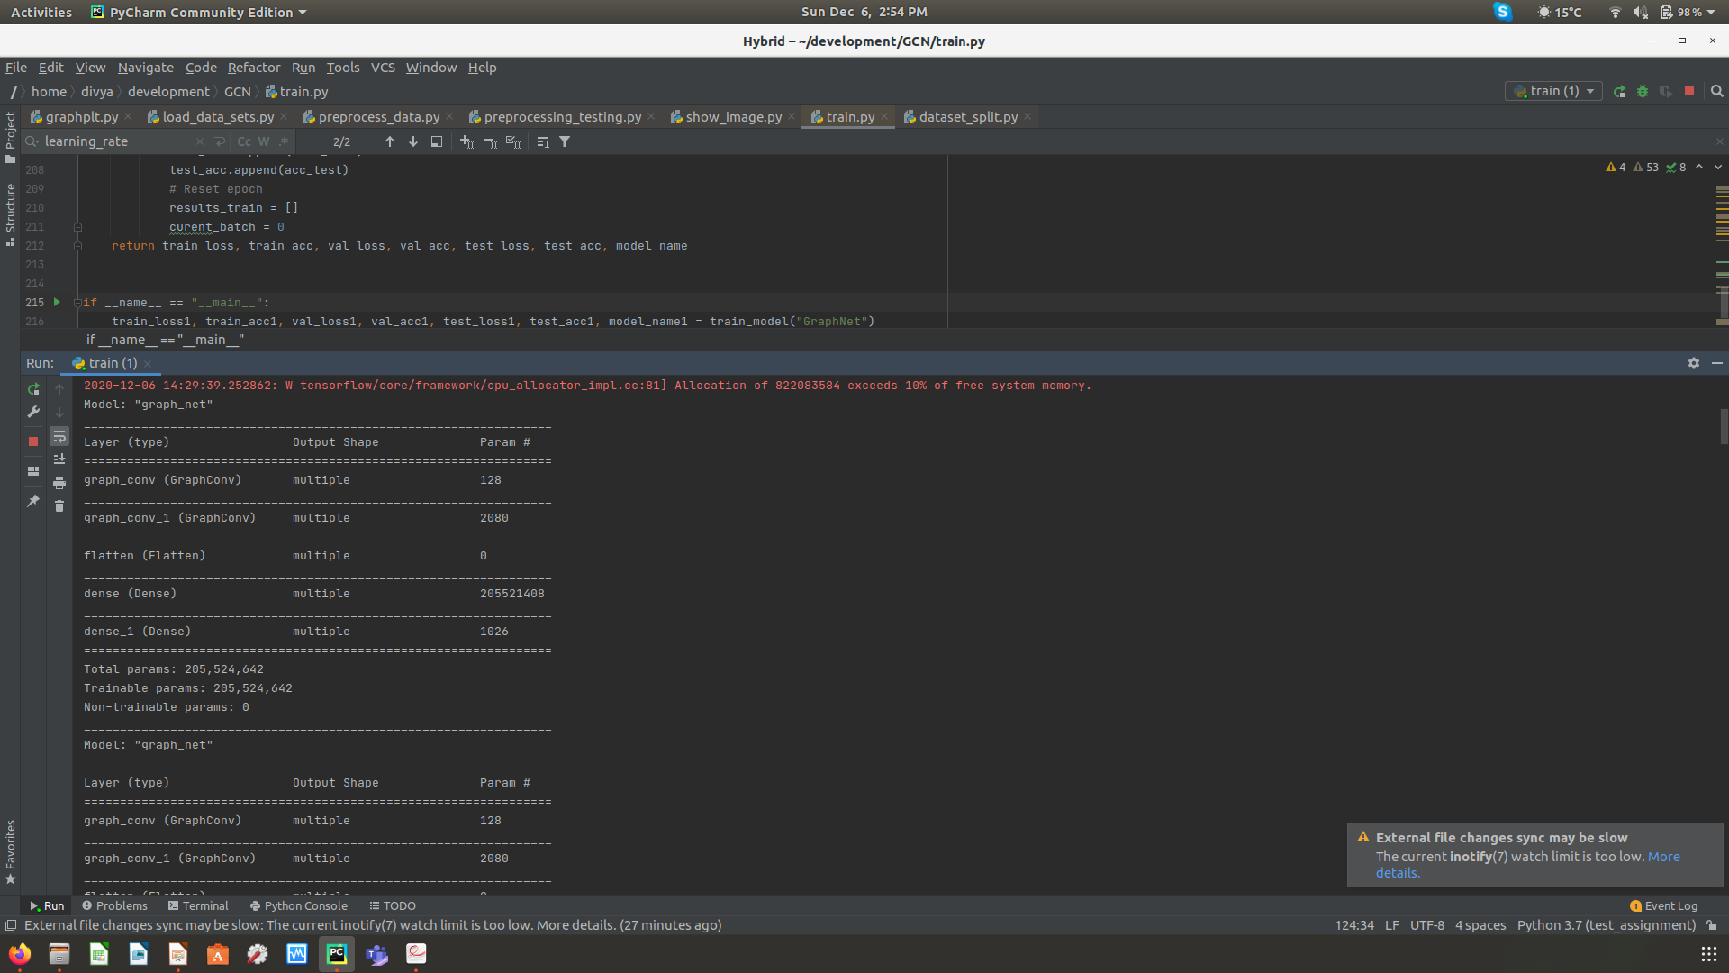
GCN
Model architecture:
GraphConv(64, activation='elu')
GraphConv(32, activation='elu')
Dense(512, activation='relu')
Dense(total_classes, activation='softmax')

Slide 10
Parameters Used
Batch size = 32
Number of epochs = 50
Initial Learning Rate = le-3
Optimizer = Adam
Loss = SparseCategoricalCrossentropy()
Accuracy = SparseCategoricalAccuracy()

Slide 11
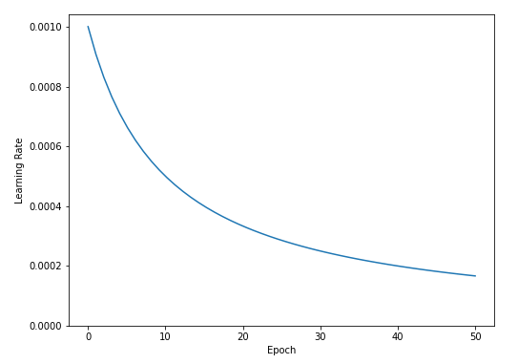
Steps to prevent overfitting
Gradually decreasing the learning rate
Using L2 regularization
Regularization factor = 4e-4
Using dropout

Slide 12
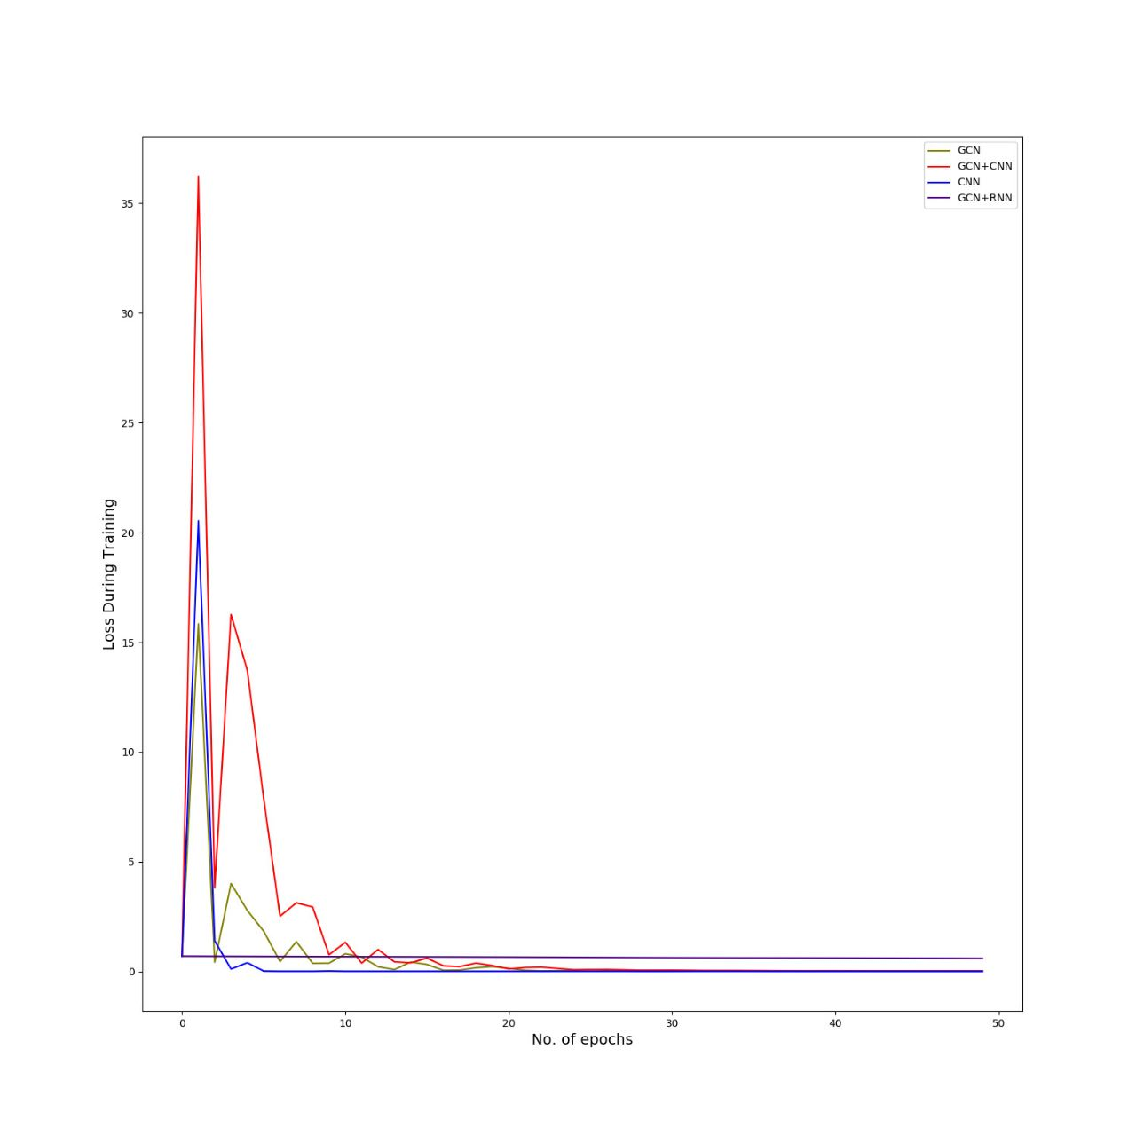
Results
Loss During Training (common_fiber_matrix)
Initially during training, Hybrid model (GCN and CNN) losses more as compared to other models.
After 50 epochs,Hybrid model (GCN and RNN) still has higher loss than others. While other models trained well after 50 epochs

Slide 13
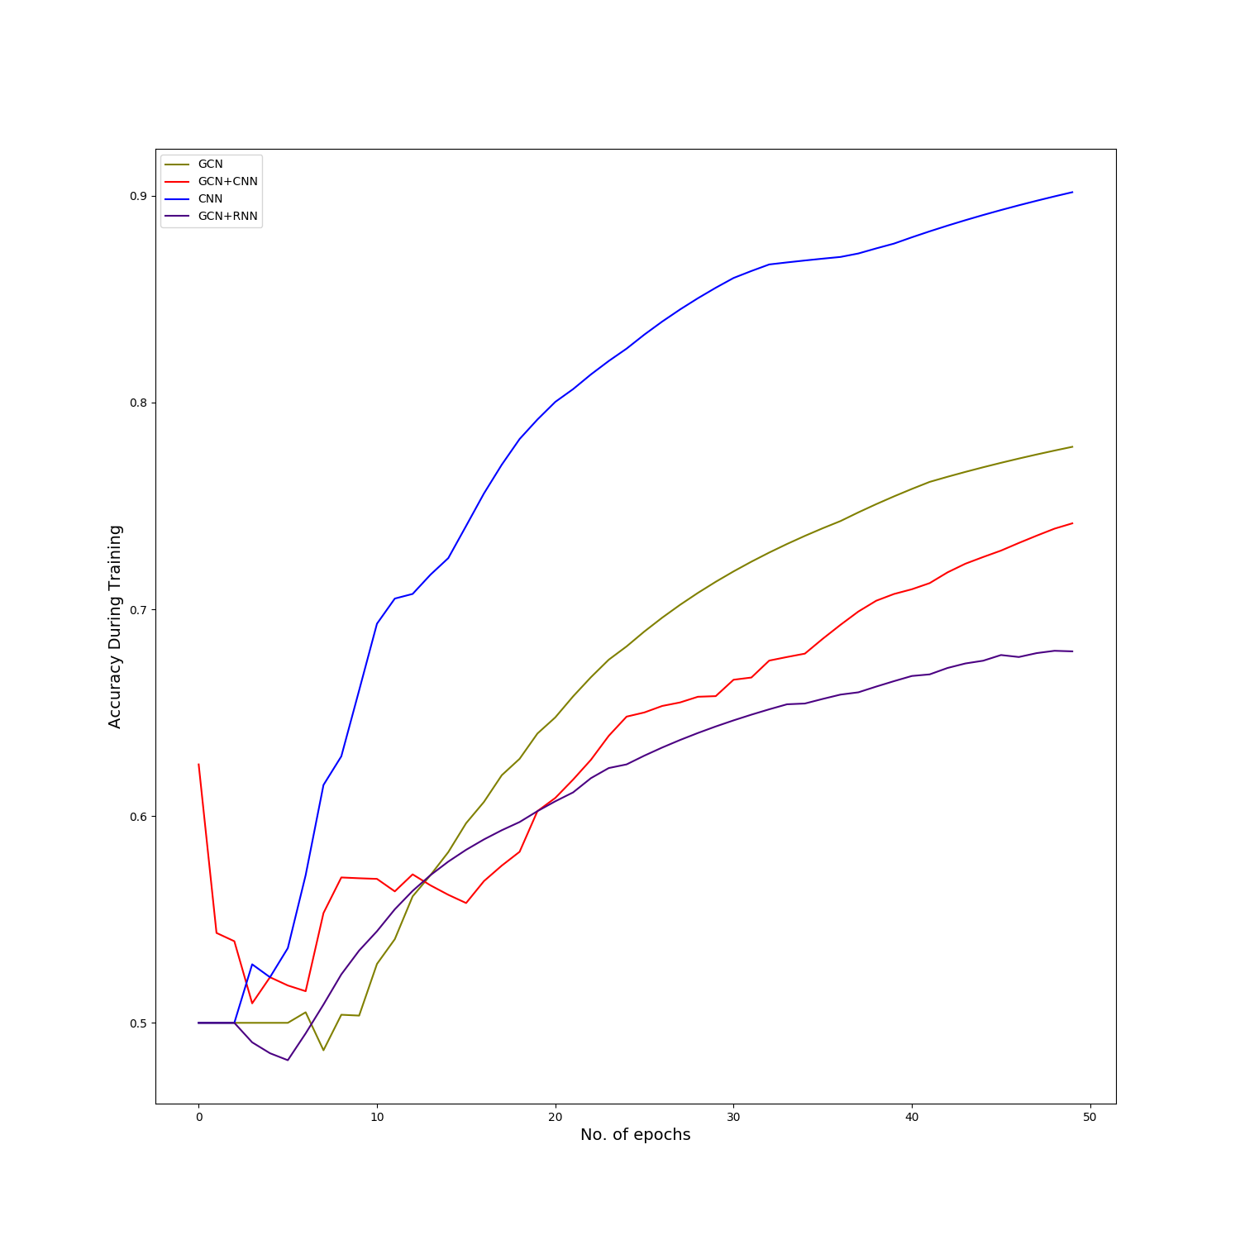
Results
Accuracy During Training (common_fiber_matrix)
CNN has highest accuracy.
Note: Training this model for another 50 epochs results in substantial overfitting.
After CNN, GCN performed well based on graph.
After GCN, hybrid model (GCN and CNN) performed well.
Lastly, it’s hybrid model (GCN and CNN).

Slide 14
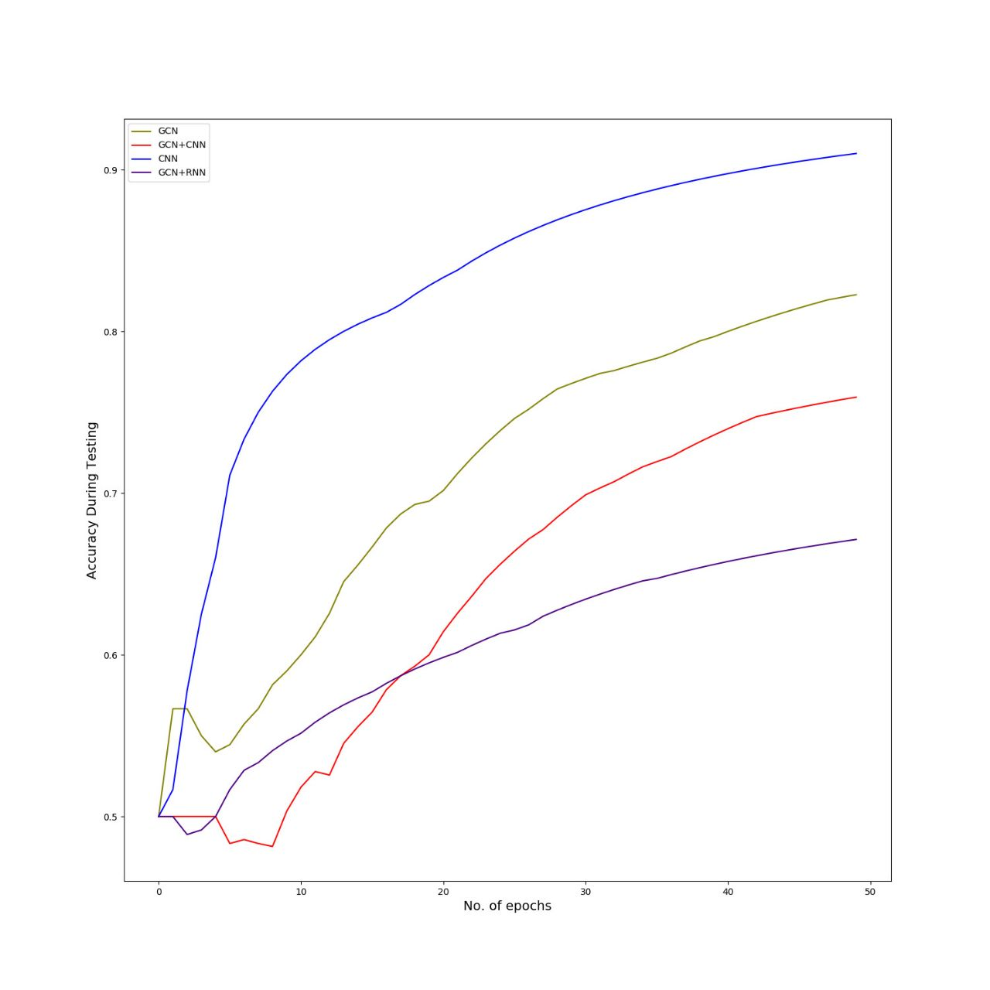
Results
Accuracy During Testing (common_fiber_matrix)
CNN has highest accuracy.
After CNN, GCN performed well based on graph.
After GCN, hybrid model (GCN and CNN) performed well.
Lastly, it’s hybrid model (GCN and CNN).

Slide 15
Results
Final Accuracies on test dataset (common_fiber_matrix)
on a scale of 0 to 1 are:
GCN + CNN is 0.741
GCN + RNN is 0.6787
CNN is 0.90
GCN is 0.777

Slide 16
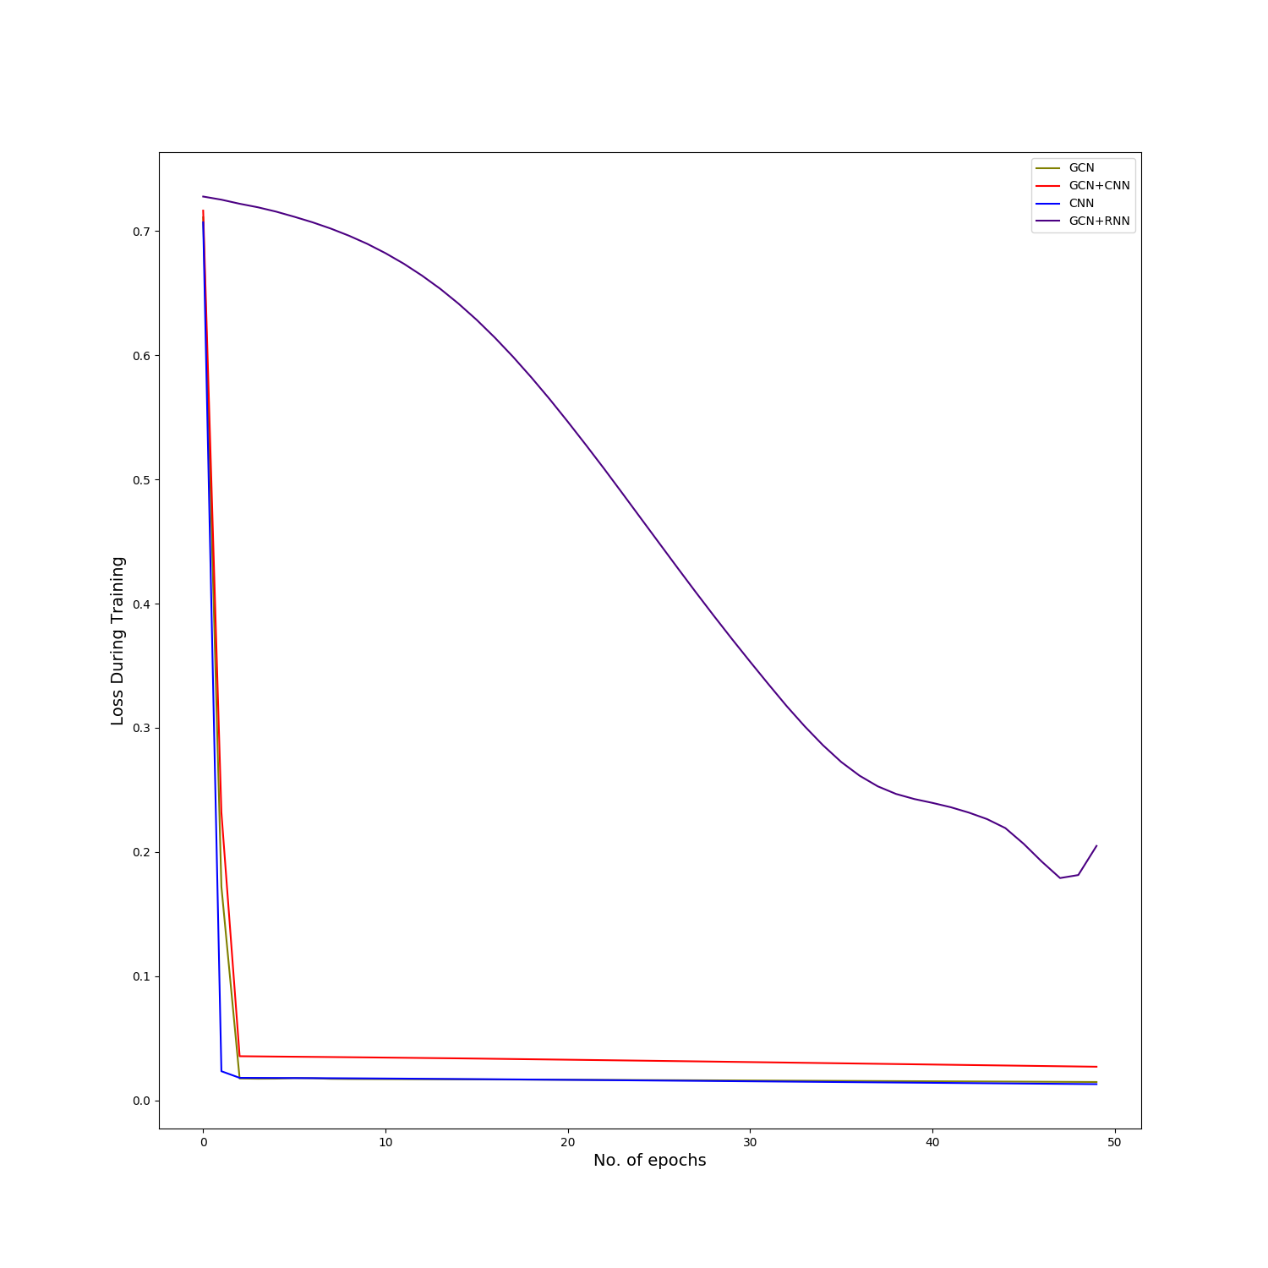
Results
Loss During Training (average_fmri_feature_matrix)
Initially during training, Hybrid model (GCN and RNN) losses more as compared to other models.
After 50 epochs, Hybrid model (GCN and RNN) still has higher loss than others. While other models trained well after 50 epochs.

Slide 17
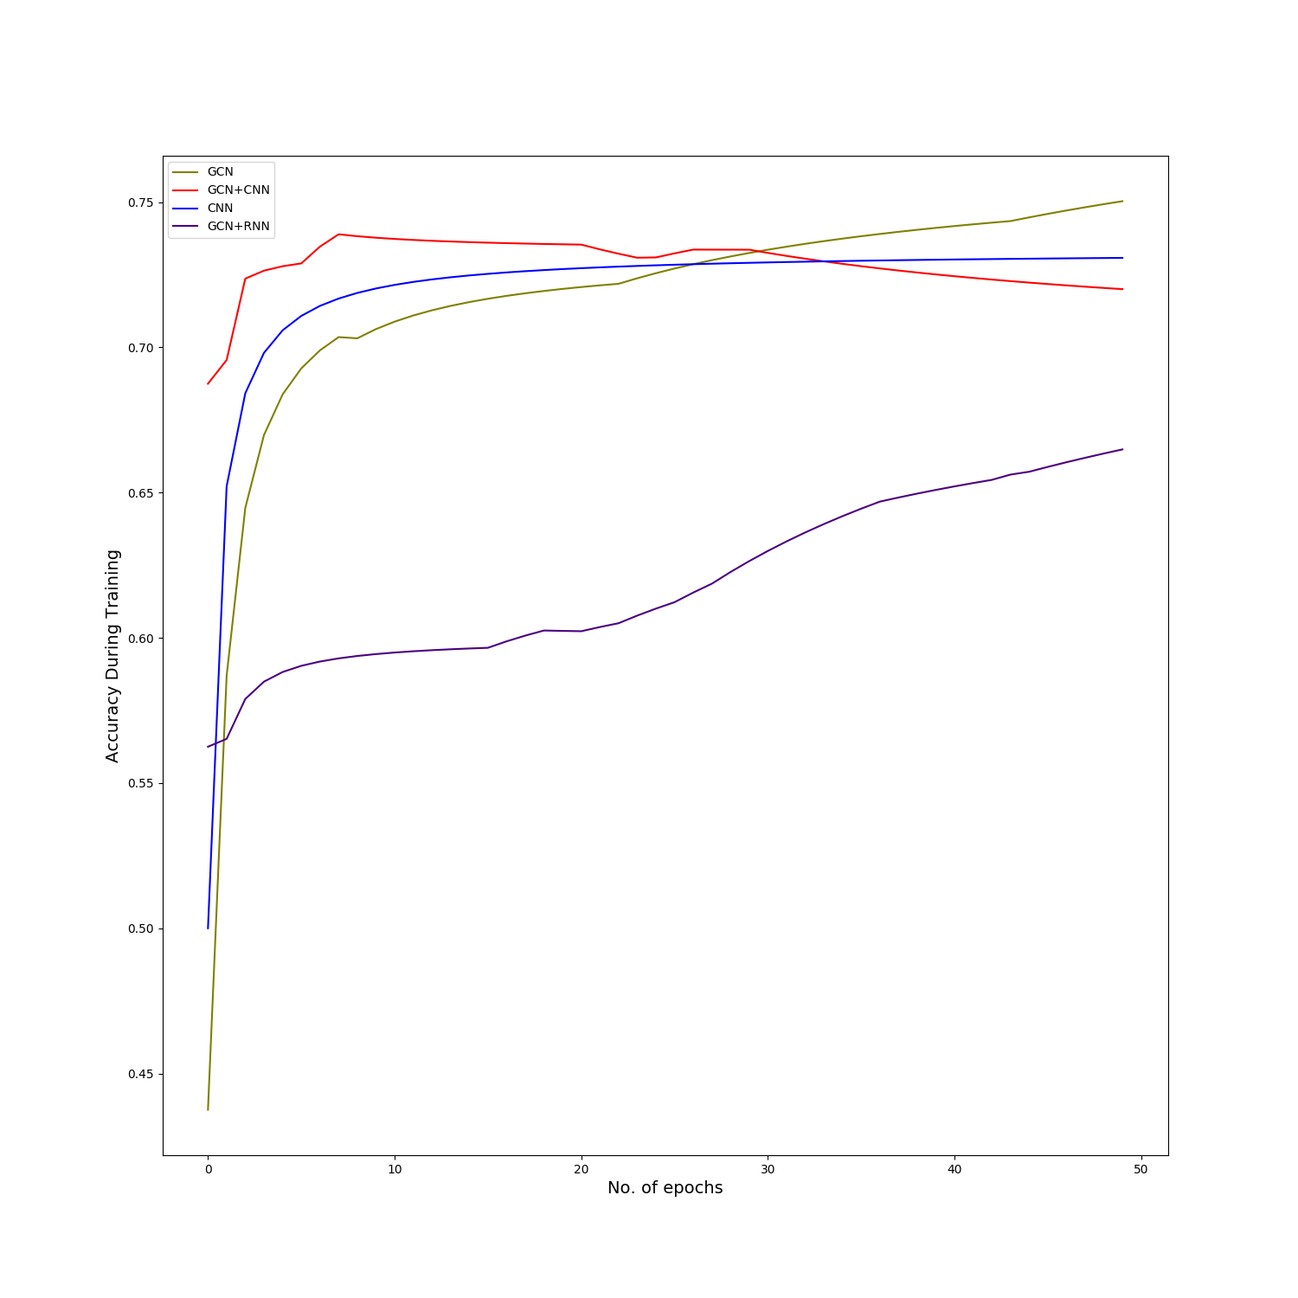
Results
Accuracy During Training (average_fmri_feature_matrix)
GCN has highest accuracy.
After GCN, CNN performed well based on graph.
After CNN, hybrid model (GCN and CNN) performed well.
Lastly, it’s hybrid model (GCN and RNN).

Slide 18
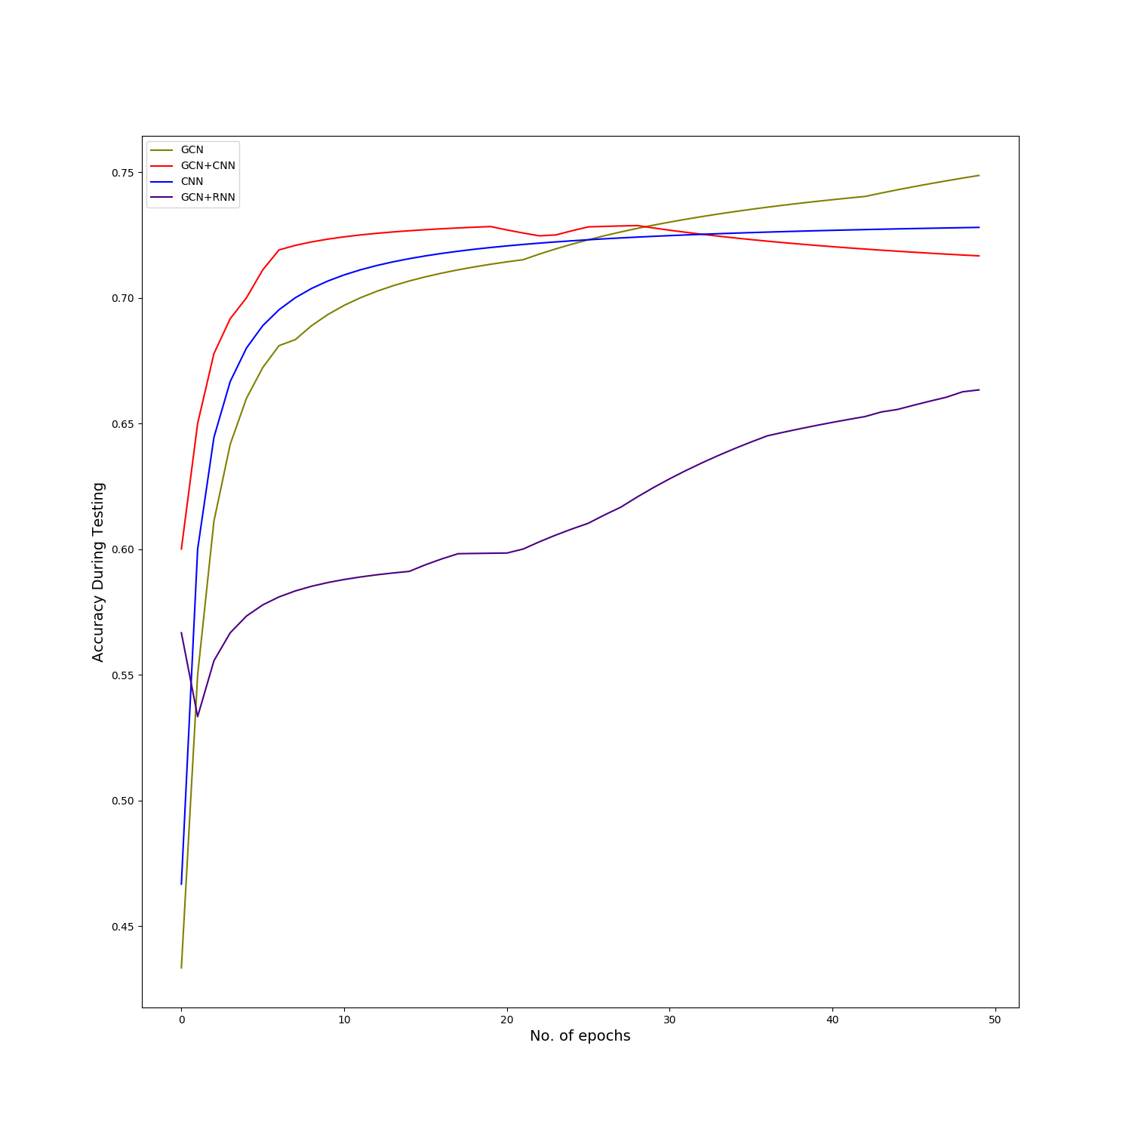
Results
Accuracy During Testing (average_fmri_feature_matrix)
GCN has highest accuracy
After GCN, CNN performed well based on graph.
After CNN, hybrid model (GCN and CNN) performed well.
Lastly, its hybrid model (GCN and CNN).

Slide 19
Results
Final Accuracies on test dataset (average_fmri_feature_matrix)
on a scale of 0 to 1 are:
GCN + CNN is 0.7161
GCN + RNN is 0.663
CNN is 0.728
GCN is 0.748

Slide 20
Conclusion
 | average_fmri_feature_matrix | common_fiber_matrix
GCN + CNN | 0.7161 | 0.741
GCN + RNN | 0.663 | 0.6787
CNN | 0.728 | 0.90
GCN | 0.748 | 0.777
GCN + CNN performed almost same for both datasets +-.05
GCN + RNN is not a good model, performed worst in all the models tested.
CNN model performed well for common_fiber_matrix dataset (approx 90% accuracy)
GCN performed almost same for both datasets +-.04

Slide 21
Thank You!

